Slide 1
How to delete an invoice that has already used a sequence

Slide 2
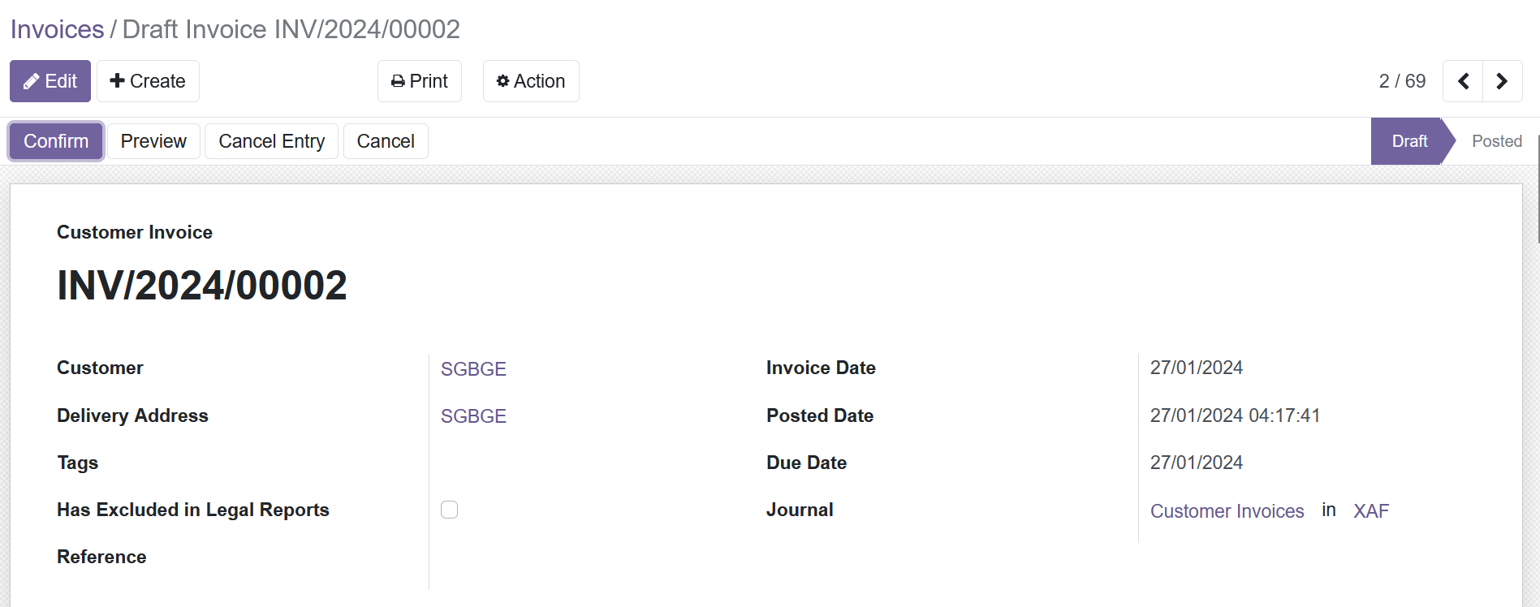
Invoice form view
Invoice to be deleted must be in draft state

Slide 3
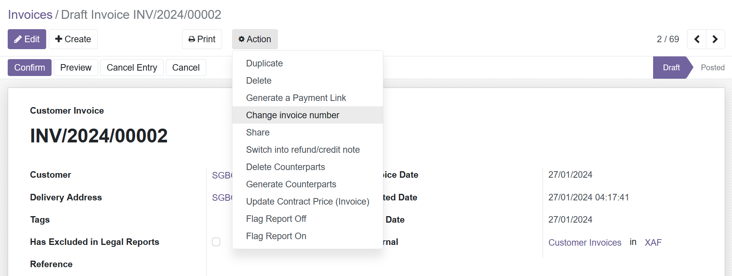
Invoice form view
Go to Action > Change Invoice Number

Slide 4
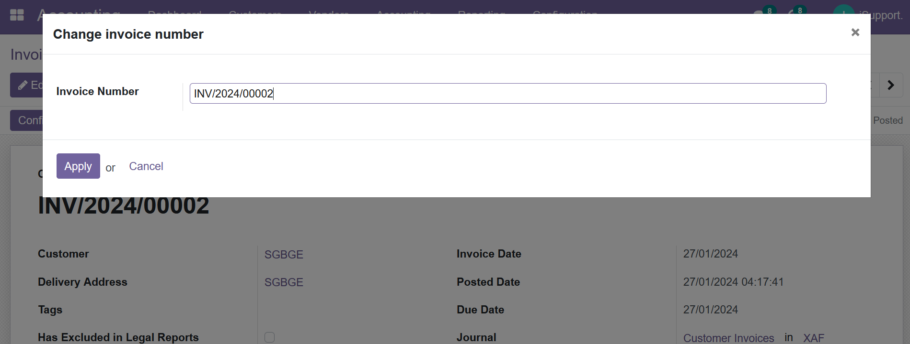
Invoice form view
Delete the invoice number and leave this field blank

Slide 5
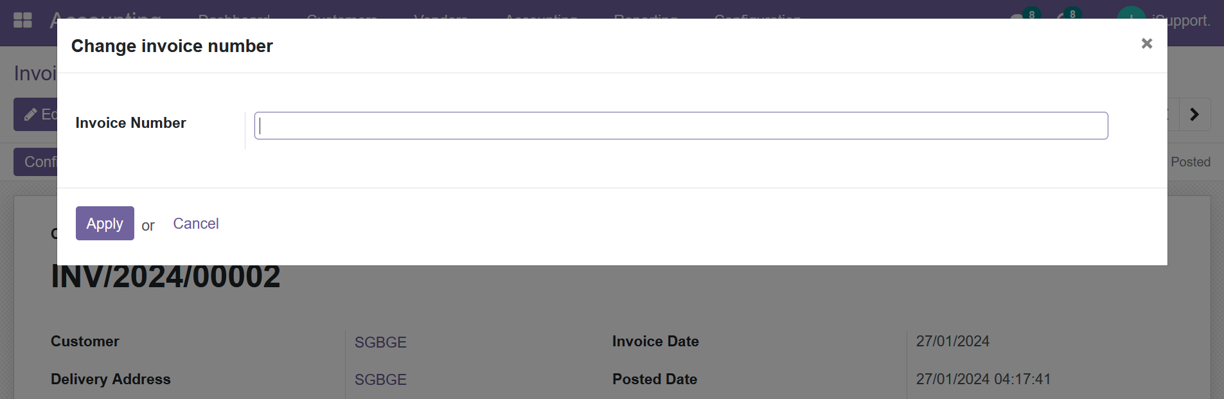
Invoice form view
Click on Apply

Slide 6
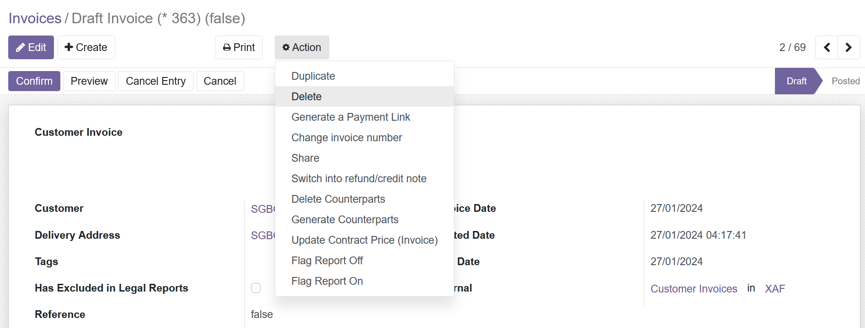
Invoice form view
Go back to Action and select Delete

